Slide 1
Motion and Optical Flow

Slide 2


The cause of motion
Three factors in imaging process
Light
Object
Camera
Varying either of them causes motion
Static camera, moving objects (surveillance)
Moving camera, static scene (3D capture)
Moving camera, moving scene (sports, movie)
Static camera, moving objects, moving light (time lapse)

Slide 3
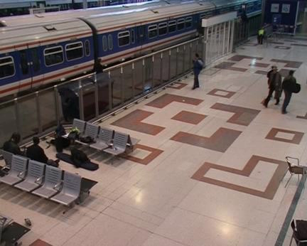
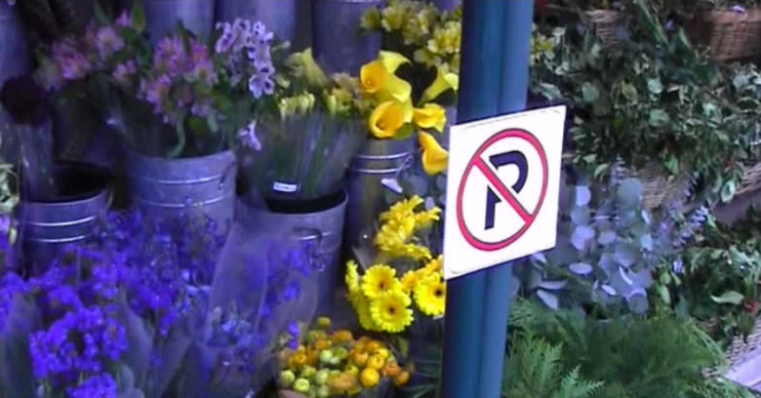
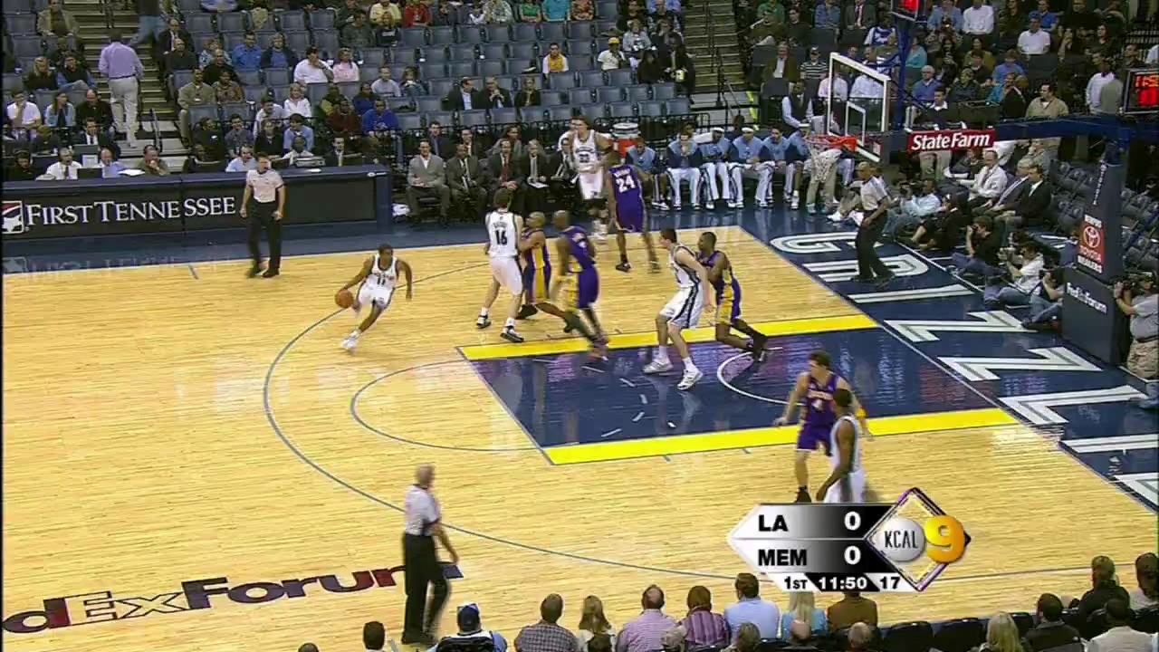
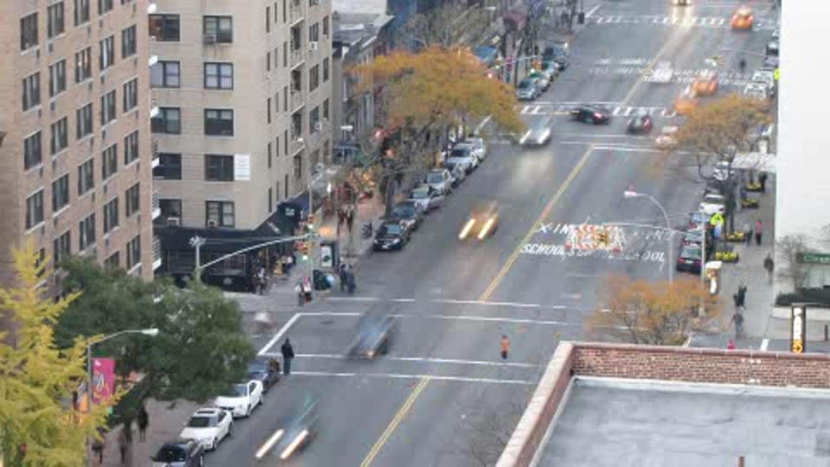
Motion scenarios (priors)
Static camera, moving scene
Moving camera, static scene
Moving camera, moving scene
Static camera, moving scene, moving light

Slide 4
How can motion be recovered? Recovering motion
Feature-tracking
Extract visual features (corners, textured areas) and “track” them over multiple frames
Optical flow
Recover image motion at each pixel from spatio-temporal image brightness variations (optical flow)
Two problems, one registration method
B. Lucas and T. Kanade. An iterative image registration technique with an application to
stereo vision. In Proceedings of the International Joint Conference on Artificial Intelligence, pp. 674–679, 1981.

Slide 5
Feature tracking
Challenges
Figure out which features can be tracked
Efficiently track across frames
Some points may change appearance over time (e.g., due to rotation, moving into shadows, etc.)
Drift: small errors can accumulate as appearance model is updated
Points may appear or disappear: need to be able to add/delete tracked points

Slide 6
Feature tracking
I(x,y,t)
I(x,y,t+1)
Given two subsequent frames, estimate the point translation
Key assumptions of Lucas-Kanade Tracker
Brightness constancy: projection of the same point looks the same in every frame
Small motion: points do not move very far
Spatial coherence: points move like their neighbors

Slide 7
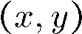
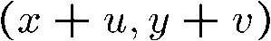
The brightness constancy constraint
I(x,y,t)
I(x,y,t+1)
Brightness Constancy Equation:
Take Taylor expansion of I(x+u, y+v, t+1) at (x,y,t) to linearize the right side:
Image derivative along x
Difference over frames
So:
Notes:
Brightness constancy equation is equivalent to minimizing the squared error of I(t) and I(t+1)

Slide 8
The brightness constancy constraint
Can we use this equation to recover image motion (u,v) at each pixel?
How many equations and unknowns per pixel?
One equation (this is a scalar equation!), two unknowns (u,v)
The component of the motion perpendicular to the gradient (i.e., parallel to the edge) cannot be measured
If (u, v) satisfies the equation, so does (u+u’, v+v’ ) if

Slide 9
The aperture problem
Actual motion

Slide 10
The aperture problem
Perceived motion

Slide 11

The barber pole illusion
http://en.wikipedia.org/wiki/Barberpole_illusion

Slide 12


The barber pole illusion
http://en.wikipedia.org/wiki/Barberpole_illusion

Slide 13
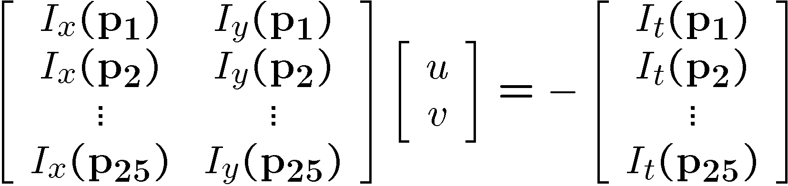
Solving the ambiguity…
B. Lucas and T. Kanade. An iterative image registration technique with an application to stereo vision. In Proceedings of the International Joint Conference on Artificial Intelligence, pp. 674–679, 1981.
How to get more equations for a pixel?
Spatial coherence constraint
Assume the pixel’s neighbors have the same (u,v)
If we use a 5x5 window, that gives us 25 equations per pixel

Slide 14
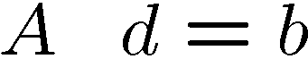



Solving the ambiguity…
Least squares problem:

Slide 15
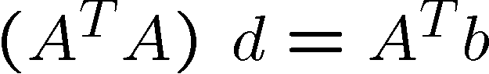
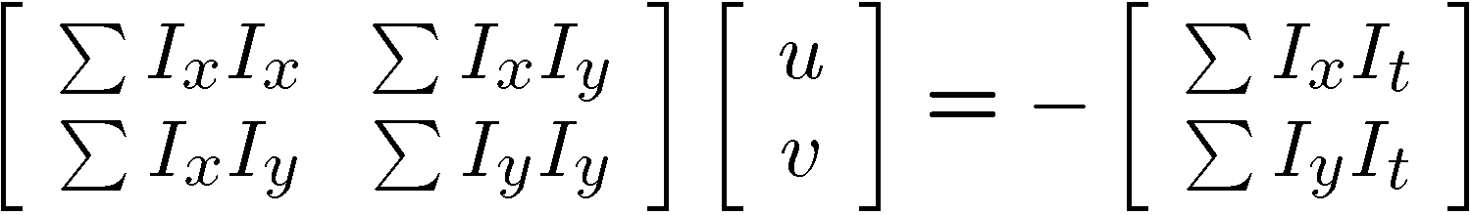
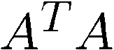
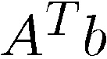
Matching patches across images
Overconstrained linear system
Least squares solution for d given by
The summations are over all pixels in the K x K window

Slide 16
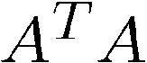
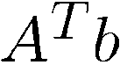
Conditions for solvability
Optimal (u, v) satisfies Lucas-Kanade equation
When is this solvable? I.e., what are good points to track?
A^{T}A should be invertible
A^{T}A should not be too small due to noise
eigenvalues λ₁ and λ ₂ of A^{T}A should not be too small
A^{T}A should be well-conditioned
λ ₁/ λ ₂ should not be too large (λ ₁ = larger eigenvalue)
Does this remind you of anything?
Criteria for Harris corner detector

Slide 17
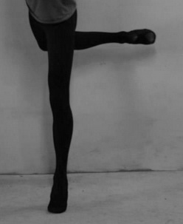





Aperture problem
Corners
Lines
Flat regions
Notes:
How computer sees the motion in flow estimation?

Slide 18
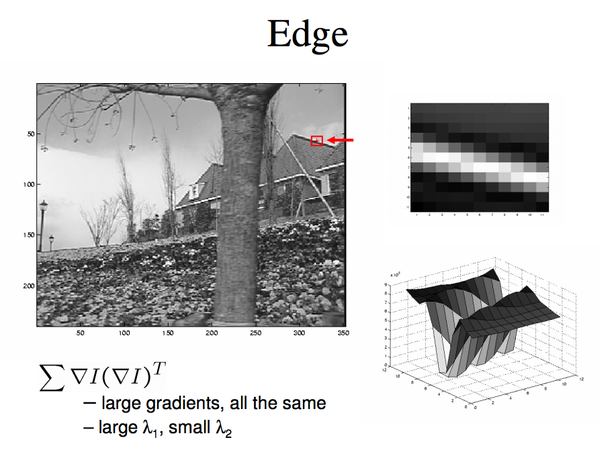

Slide 19
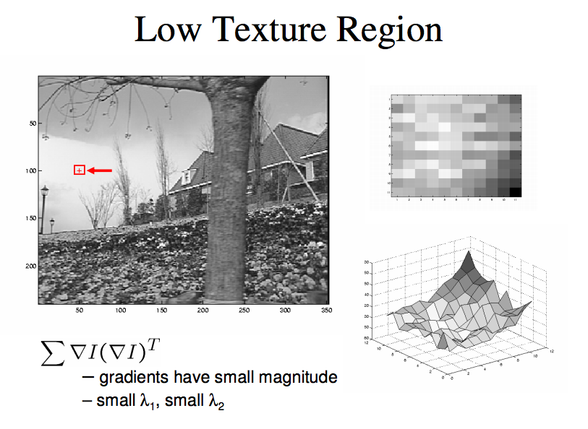

Slide 20
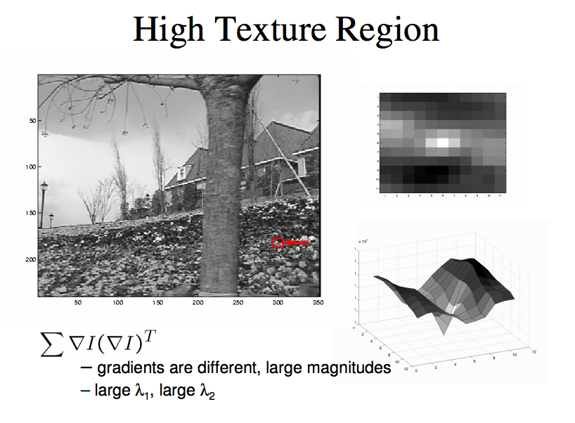

Slide 21
Errors in Lukas-Kanade
What are the potential causes of errors in this procedure?
Suppose A^{T}A is easily invertible
Suppose there is not much noise in the image
When our assumptions are violated
Brightness constancy is not satisfied
The motion is not small
A point does not move like its neighbors
window size is too large
what is the ideal window size?

Slide 22
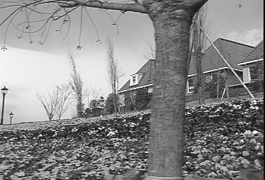
Revisiting the small motion assumption
Is this motion small enough?
Probably not—it’s much larger than one pixel (2nd order terms dominate)
How might we solve this problem?

Slide 23
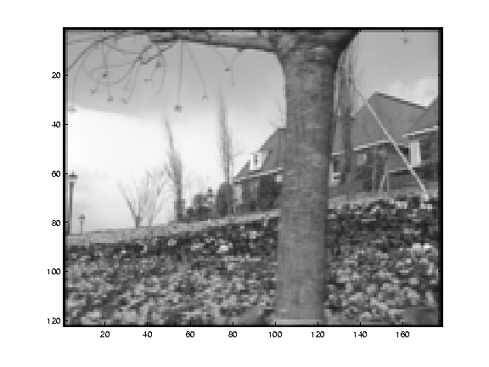
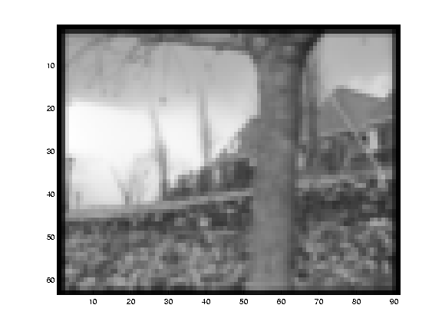
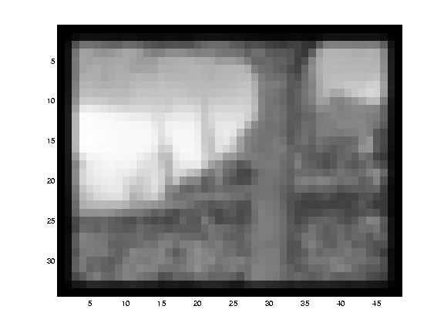
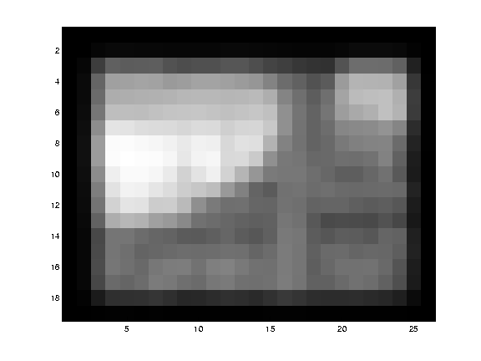
Reduce the resolution!

Slide 24
Coarse-to-fine optical flow estimation
run iterative L-K
warp & upsample
run iterative L-K
.
.
.
image J
image I
image 1
image 2
Gaussian pyramid of image 1 (t)
Gaussian pyramid of image 2 (t+1)

Slide 25
A Few Details
Top Level
Apply L-K to get a flow field representing the flow from the first frame to the second frame.
Apply this flow field to warp the first frame toward the second frame.
Rerun L-K on the new warped image to get a flow field from it to the second frame.
Repeat till convergence.
Next Level
Upsample the flow field to the next level as the first guess of the flow at that level.
Apply this flow field to warp the first frame toward the second frame.
Rerun L-K and warping till convergence as above.
Etc.

Slide 26
Coarse-to-fine optical flow estimation
u=1.25 pixels
u=2.5 pixels
u=5 pixels
image H
u=10 pixels
image I
image 1
image 2
Gaussian pyramid of image 1
Gaussian pyramid of image 2

Slide 27
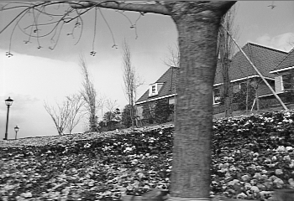
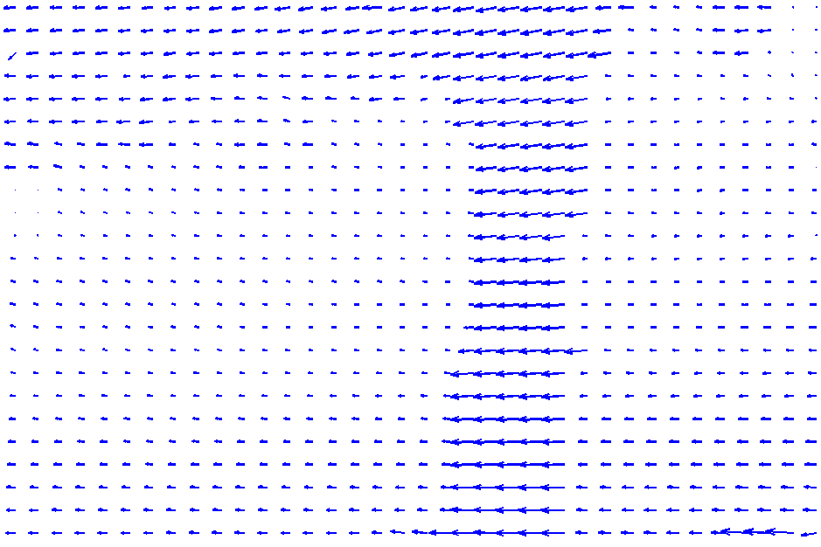
The Flower Garden Video
What should the
optical flow be?

Slide 28
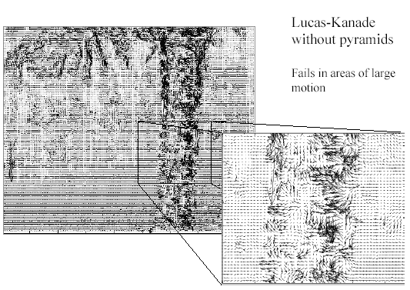
Optical Flow Results
* From Khurram Hassan-Shafique CAP5415 Computer Vision 2003

Slide 29
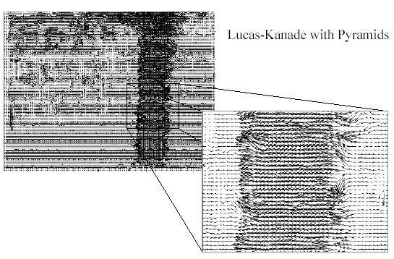
Optical Flow Results
* From Khurram Hassan-Shafique CAP5415 Computer Vision 2003

